Slide 1
Final Project Blackjack
By Zee Pearson

Slide 2
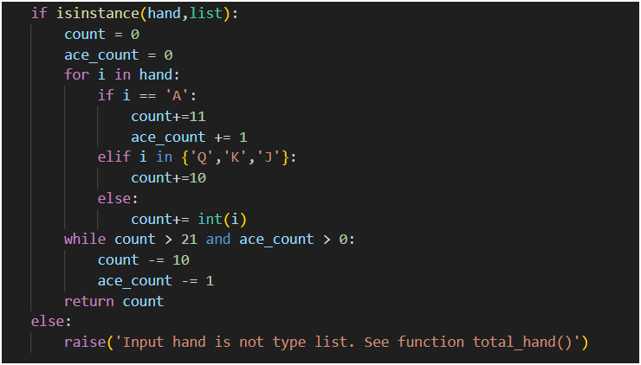
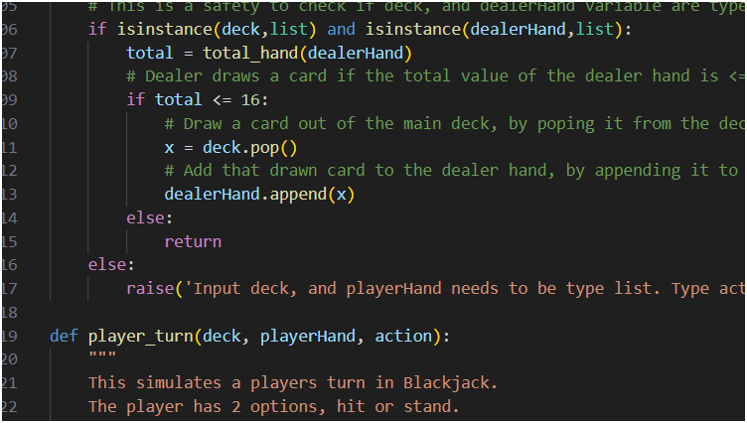
Code Docs
Final Product
Program Overview
Flow Charts
Function Overview

Slide 3
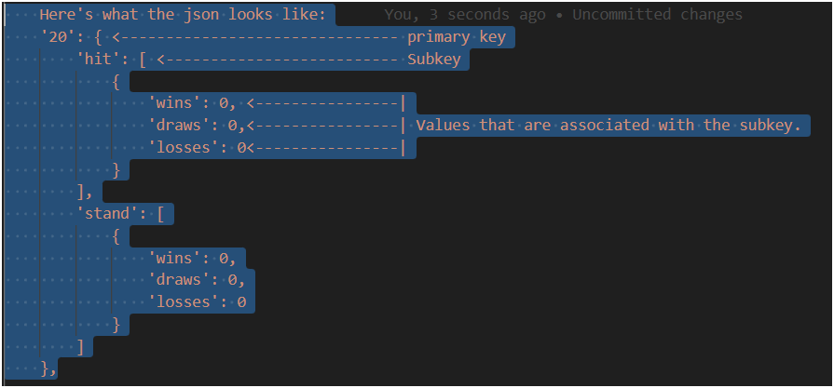
Program Overview
I used a Json file to stored the simulated output.

Slide 4
Flow Chart
player_turn
total_hand
dealer_turn
main
reset
update_json
Notes:
For the program flow chart main calls player_turn, dealer_turn, reset, update_json. Both player_turn, and dealer_turn calls the total_hand function.

Slide 5
Function Overview
Player_turn function
How the code works?:
First it checks to see if the parameters deck, playerHand, and action are a certain data type.
If not it raises an ValueError.
If action is equal to 'hit':
Stored the calculated player hand in a variable called total.
If the total < 21:
This means the player hand is not a bust, so that player can draw a card.
Player will draw a card out from the deck, by popping a value from the deck list.
Stored that value in a variable called x.
Add that card to the players hand, by appending that value to the playerHand list.
Else if action is equal to 'stand':
I used a return statement so that it exit the function.
Dealer_turn function
How does the code work?:
First it checks deck, and dealerHand to make sure they are a list type.
Then it calculates the total value of the hand, by calling the total_hand function.
Stores the calculated value in a variable called total.
In Blackjack the rule is if the dealer hand is less than 16, then it must hit.
Once the dealer hits, it pops a card off the deck, and stores it in a variable called x.
Once the card is pop off, then it adds the card to the dealer hand, by appending it to the dealer list.
Else:
returns nothing

Slide 6
Function Overview
Total_hand function
How the code works?:
Declare and initialize count and ace_count.
Count keeps track of the total value of the hand, while ace_count keeps track of the number of aces.
Used a for loop to loop through the list.
Check each index so see if the index is an Ace, Queen, King, Jack.
If the current 'i' is A:
then add 11 to count
increase ace_count by 1
Else if i in a set that contains {'Q','K','J'}:
then add 10 to count
Else:
convert i into an int, then add it to count
While count > 21 and ace_count > 0
subtract 10 from count, so that the Ace can be counted as 11
subtract 1 from ace_count. This way if there's more than one Ace in the hand, it converts all Ace's to one, since more than one Ace will be a bust.
Return count.
Reset function
How does it work?:
Check the instance of all the parameters.
If player hand, dealer hand, and deck are not list type, then raise an ValueError in the console.
Clear player_hand so that the player can start with a new hand that is empty.
Clear the dealer_hand so that the dealer can start with a new hand that is empty.
Clear the deck so that all 52 cards can be added back.
Add all the cards back to the deck, by using the append method for deck list.
Shuffle the new deck, by using the random.shuffle method.
Have the dealer, and player draw 2 cards each.
This is done by popping the main deck, then store it in a variable.
Once popped then append the cards to either, player hand, or dealer hand.

Slide 7
Function Overview
Update_json Function
The update json function will update wins/draws/losses from hit, and stand.
Each hit, and stand contains a list, and inside that list is a set of values, wins, draws, losses.
If the players action is a hit, and wins that hit, then it will add a 1 to wins.
This code, x[str(key)][str(subkey)][0]['wins']+=1, will had 1 to the wins value.
The variable key contains values ranging from 4-22. ---> x[str(key)]
The variable subkey contains values ranging from hit, or stand. ---> [str(subkey)]
The [0] means access the first index of the list. Inside the index will contain a set. ---> [0]
"wins" is the value in a set, which is a list. ---> ['wins']

Slide 8
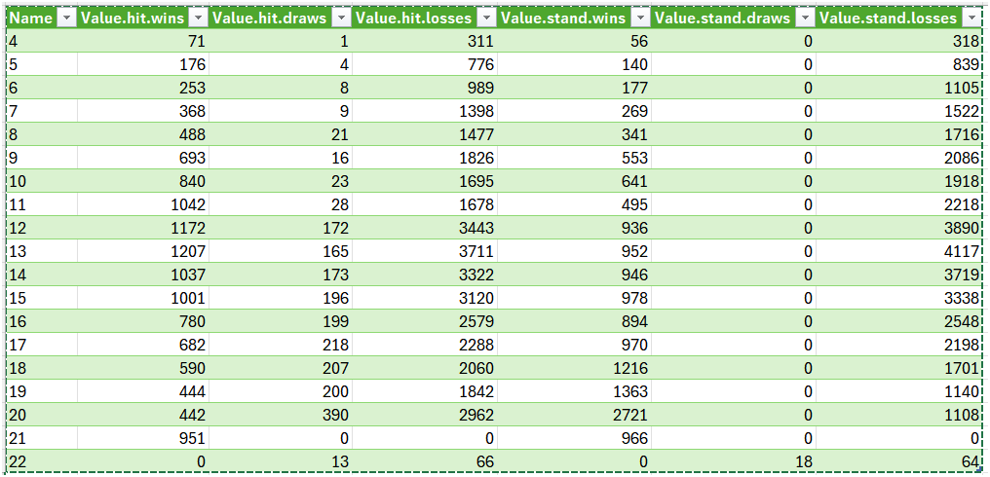
Table showing the output

